Slide 1
Apple Retail Demand Forecasting
& Promotional Impact Analyzer
An end-to-end finance project built on Apple's FY2025 10-K and FY2025–FY2026 10-Q filings.
SQL + multi-model forecasting + AI-drafted commentary, every number reconciled to source.
Portfolio piece for Senior Financial Analyst, Retail Finance (req. 200656951-0836)
[Candidate Name] · Drafted from public SEC filings

Slide 2
Built around the four pillars of the JD
Each pillar mapped to a concrete deliverable on real Apple data — not toy datasets.
Strategic Analysis
Forecasting
2-page executive memo
6-model ensemble
Four insights surfacing margin lever, China uncertainty, Wearables risk, and forecast judgment calls.
Walk-forward backtest across 10 series. Champion model identified per series; bias-corrected forecast with bootstrap CIs.
docs/executive_memo.md
scripts/forecast_models.py
Business Partnering
Process Innovation
Narrative notebook
AI commentary drafter
Jupyter narrative explaining the forecast for a non-technical reviewer — the kind of work product Geo Finance partners would consume.
Anthropic API + sentence-scoped number-grounding validator. Catches the cardinal LLM-in-finance failure: confidently inventing numbers.
notebooks/02_forecast.py
scripts/generate_commentary.py

Slide 3
Data foundation: 16 reconciliations to the dollar
Every fact in the database ties to a published SEC filing. Build fails with exit code 2 if any check breaks.
5
90
16
70
filings parsed
quarterly observations
reconciliations passing
automated tests
FY25 10-K + four 10-Qs
9 quarters × 10 series
to the dollar
all green
Pipeline
EDGAR XBRL .zip
iXBRL parser
Quarterly CSVs
SQLite star schema
8 + 6 analytical queries
Annual P&L (segment + product + consolidated) · 9 quarters × 10 series · Q4 derived by subtraction (flagged)

Slide 4
Six-model walk-forward ensemble
No single technique dominates. Different models win for different patterns — that's the realistic answer.
Base models
Validation discipline
Naive Last
y_t+1 = y_t · floor baseline
Walk-forward CV
Train on y[:k], predict y[k], expand. 5 backtest predictions per series.
Inverse-MAPE ensemble weights
Models that backtest well get more weight. No model excluded.
Bias correction + bootstrap CIs
Residual mean → point shift; demeaned residuals → 80% intervals.
Multi-horizon (Q2/Q3/Q4 FY26)
Native multi-step prediction; CI scaled by √h (random-walk approx).
Seasonal Naive
y_t+1 = y_t-3 · same quarter, prior year
CAGR
Geometric trend on log(y)
Holt-Winters
Level + trend + seasonality (additive)
Ridge
L2-regularized lag features + seasonals
Gradient Boosting
sklearn GBM on engineered features
Champion model per series — Holt-Winters wins 6/10 · Seasonal Naive wins 3/10 · CAGR wins 2/10 (Services, Mac). Best MAPE: Services 1.2%, Wearables 3.8%, Mac 5.0%.

Slide 5
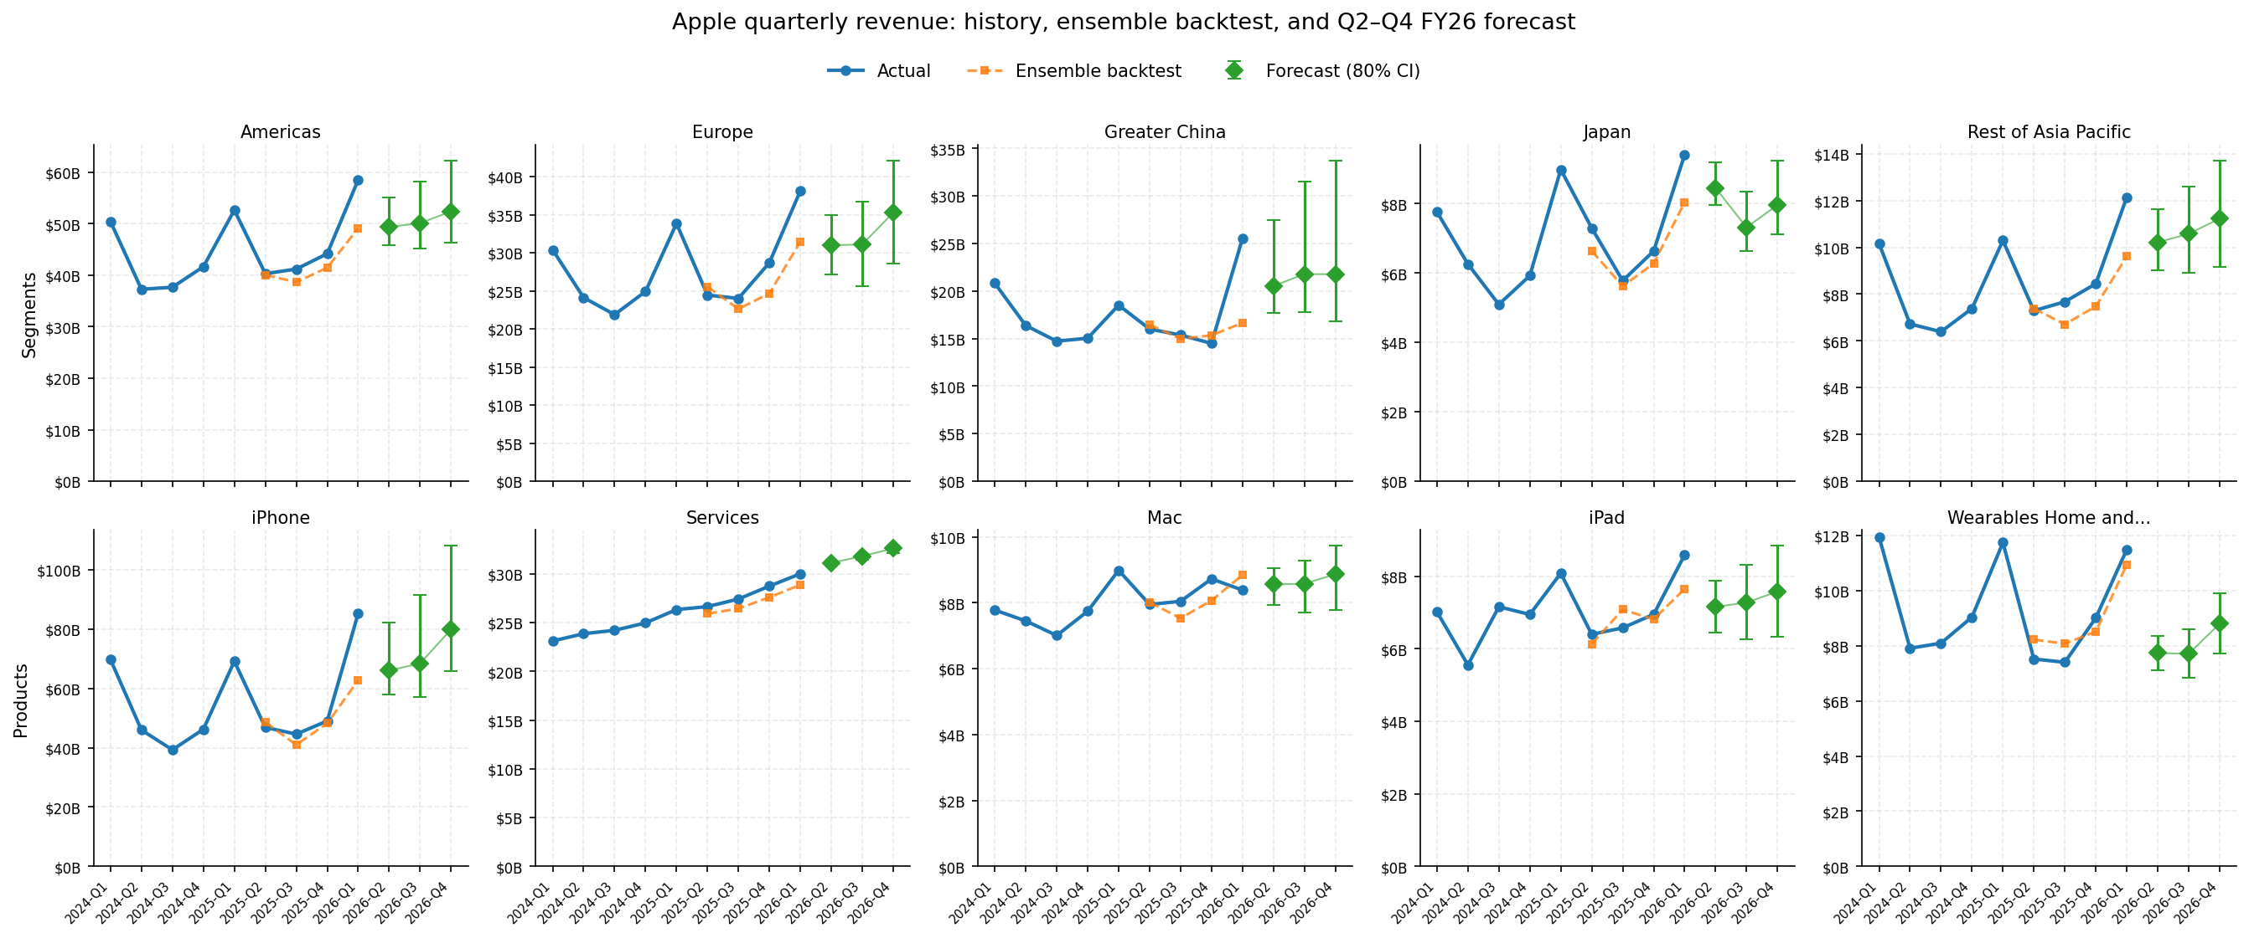
Q2–Q4 FY2026 forecast across 10 series
Three forecast quarters per series. Total revenue trajectory ~$120B (Q2) → ~$122B (Q3) → ~$133B (Q4). Confidence bands widen by √h with horizon — Q4 bands are roughly 1.7× Q2 bands.
Top row: 5 segments · Bottom row: 5 product categories · Three diamonds per panel = Q2/Q3/Q4 FY26 · Hover the interactive version (docs/interactive_forecast.html) for exact values per point

Slide 6
AI-drafted commentary, with hallucination guardrails
Three-layer pipeline. The model never reads the database; it sees only a typed brief. Every number in its output is verified against that brief.
1
Brief generator
2
Anthropic API client
3
Number-grounding validator
commentary_brief.py
commentary_client.py
commentary_validator.py
Pulls structured JSON from the DB. Three flavors: period-vs-period, year-over-year, forecast-vs-baseline. Computes pattern observations as hints.
Senior FP&A persona. 250-350 words, 3-4 paragraphs. Critical constraint: only use numbers from the brief. Dry-run mode if no API key.
Regex-extract every $ and %. Sentence-scoped, entity-aware matching. Catches 'Greater China was $30B' even when $30B exists in the brief for a different entity.
Demo result on Q1 FY26 vs Q1 FY25 commentary: 28 / 28 numbers grounded, 0 unverified.

Slide 7
Four insights for the FY27 planning cycle
Full memo in docs/executive_memo.md · Each insight ties to a recommended action.
Services is the GM lever, not hardware
1
Greater China: hottest signal, widest band
2
Mix shift to Services drove ~75% of FY23→FY25 GM expansion (44.1% → 46.9%). Services FY26 trajectory $31.1B → $31.8B → $32.6B carries the tightest CI in the bundle (~$0.5B).
+37.9% YoY in Q1 FY26 after 4 declining quarters. Forecast trajectory $20.5B → $21.8B → $21.8B; CI band widens $9.7B → $16.9B by Q4. Highest scenario-planning value in the bundle.
Wearables decline masks Services ARPU question
3
iPhone trajectory hinges on a $6.3B bias correction
4
-7.1% / -3.6% / -2.2% across FY24 / FY25 / Q1 FY26. Watch and AirPods attach softening matters for LRP customer-LTV math, regardless of the Q4 holiday bounce in the forecast.
Bias-corrected: $66.1B → $68.4B → $79.9B (+41/53/63% YoY). Raw model is ~$6B lower at every horizon. CI widens $24B → $42B by Q4 — the wider the horizon, the more this single judgment call matters.
Bottom-right insight is highlighted in coral because it's the strongest analyst-judgment call in the forecast.

Slide 8
What's in the bundle
Reproducible data layer
Executive memo
SQLite star schema, 11 tables, build script with reconciliation against 16 control totals.
2 pages, 4 insights, recommended actions for the FY27 planning cycle.
Multi-horizon forecast pipeline
Interactive forecast viewer
6 base models, walk-forward CV, ensemble + bias correction, Q2/Q3/Q4 FY26 with √h-scaled CIs.
Self-contained HTML, hover any point for exact values, toggle base models or CI band.
AI commentary system
75 automated tests
3-layer pipeline w/ Anthropic API + sentence-scoped number-grounding validator.
30 database, 24 forecast (incl. multi-horizon), 21 commentary. All green.
All code, data, and tests reproduce end-to-end from the public SEC filings. Repository structure mirrors how a Retail Finance team would organize the same workflow internally.

